Slide 1
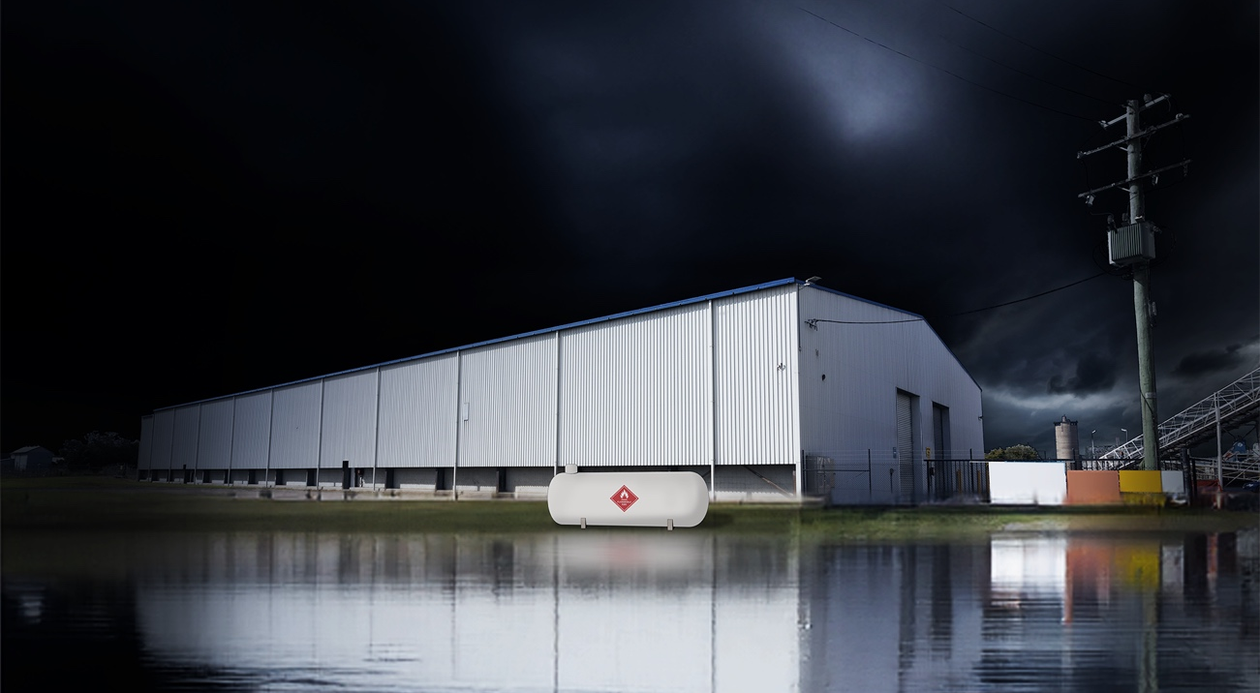

LP GAS
SAFETY
FLOODS AND STORM EVENTS.
For additional information and LP Gas safety resources, visit: gasenergyaus.au/policies.html
Notes:
SPEAKER NOTES:
Welcome!
Today we’re going to talk about LP Gas safety during flood and storm events.
This presentation will cover how to be LP Gas safe before, during and after a flood or storm event.

Slide 2
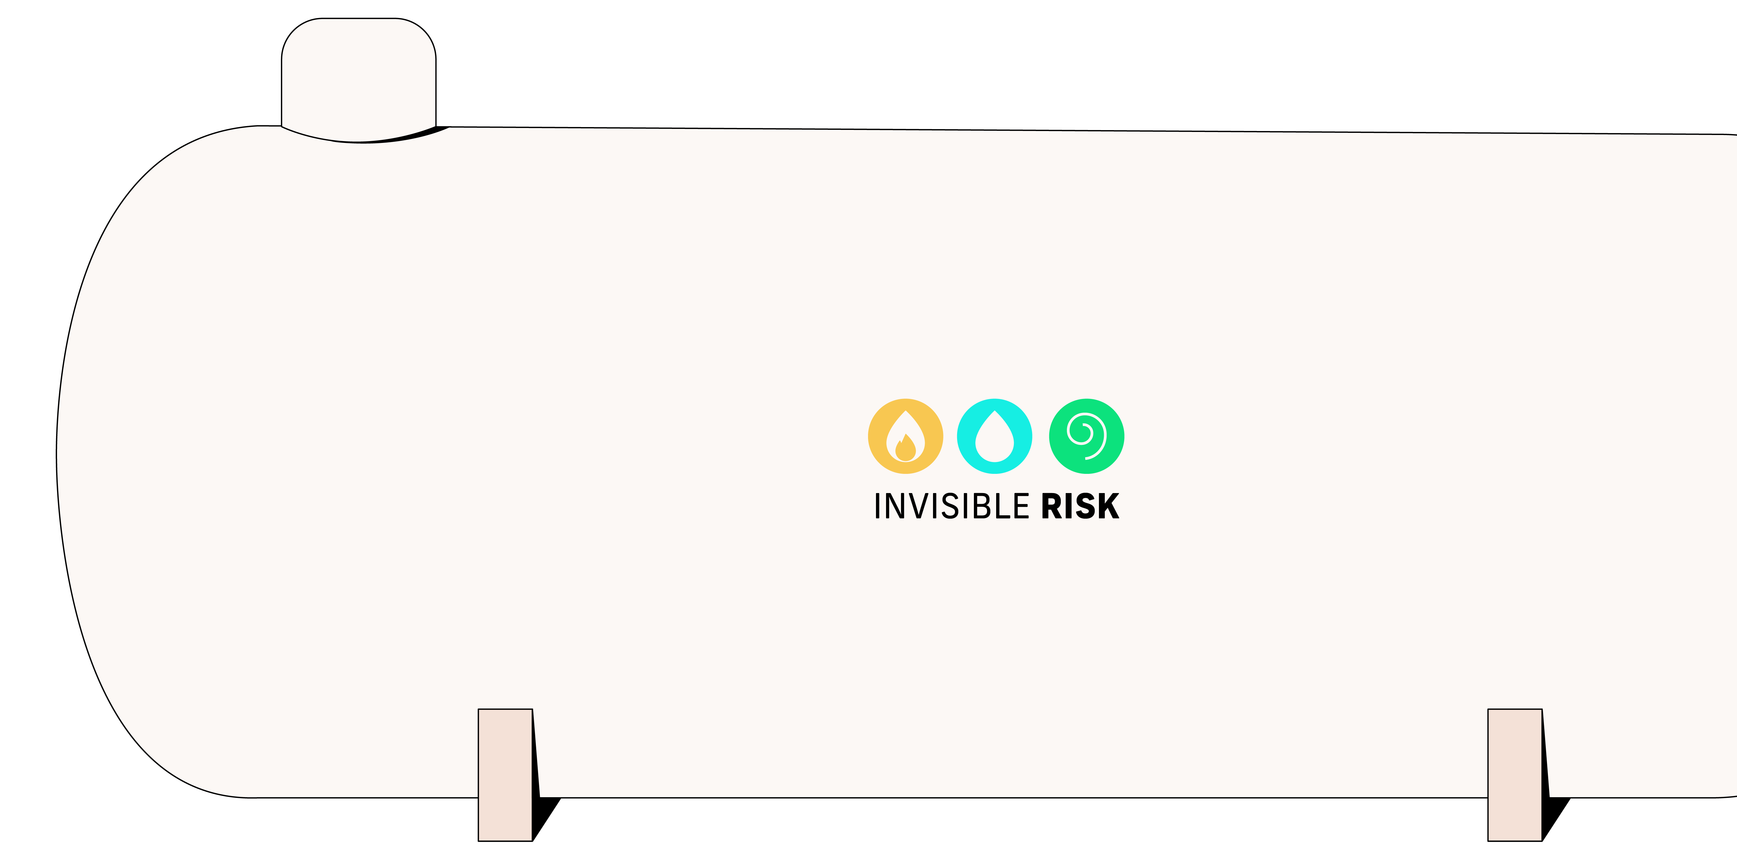

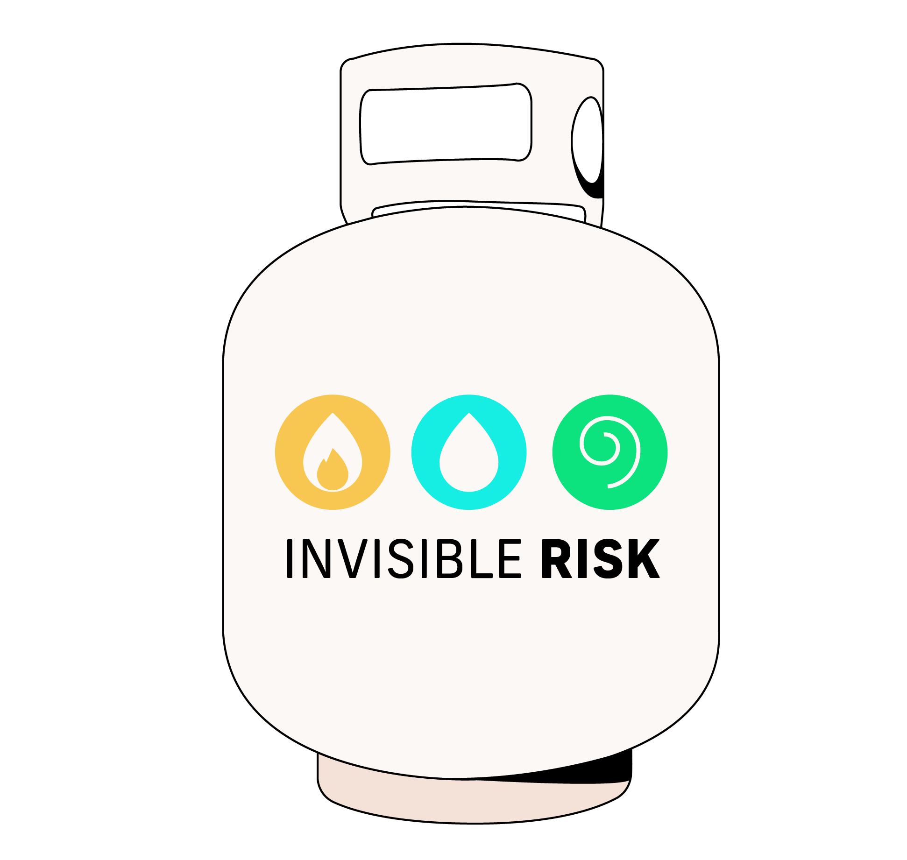
FLOODS ARE THE MOST COMMON NATURAL DISASTER IN AUSTRALIA.
WHEN FLOODS AND STORMS HIT THERE
IS A LOT THAT IS OUT OF OUR CONTROL BUT THERE ARE A FEW SIMPLE STEPS YOU CAN TAKE TO HELP PROTECT YOUR FAMILY AND COMMUNITY.
One of those things is ensuring LP Gas safety in your home or workplace. So, what can you do to prepare your sites and your communities for a flood or storm event and to help them recover?
Notes:
SPEAKER NOTES:
We’ve all seen the impact that flood and storm events have on people and communities.
Despite this, a lot of people aren’t aware of the risks associated with the LP Gas cylinders they have around their home. For them, it’s such an ordinary part of their life that they don’t remember how dangerous it can be if handled incorrectly.
So, what can we do to help both our site and our community prepare for a flood or storm event and what can we do to help them recover?

Slide 3






THERE ARE 3 PHASES
OF LP GAS SAFETY WHEN IT COMES TO FLOODS
OR STORM EVENTS.
Notes:
SPEAKER NOTES:
When we’re thinking about LP Gas safety during flood or storm events, we need to consider 3 key periods: before, during and after. At each stage we’ll need to do different things to give our community the best opportunity to bounce back.

Slide 4



GENERAL
IF YOU’RE IN AN AREA WITH A HIGH FLOOD AND STORM RISK, MAKE SURE YOUR SITE HAS:
FLOOD MITIGATION PLAN
EMERGENCY RESPONSE PLAN
BUSINESS CONTINUITY PLAN
Notes:
SPEAKER NOTES:
The first thing to consider if we’re in a flood-prone area is how prepared our site is. It’s a good idea to make sure the following three things are in place and that our team is well versed in what to do with them.
A flood mitigation plan will identify ways that we can prepare for, respond to, reduce damage from and recover from a flood or storm event.
An emergency response plan is a written set of instructions that outlines what workers should do in an emergency. It will apply to any emergency but should consider what to do in the event of a flood or storm event.
Business continuity planning helps our business respond to unexpected events and situations which can interrupt our operations. It helps us identify, prevent or reduce risks that are out of our control as well as respond and recover if an incident or crisis occurs.

Slide 5

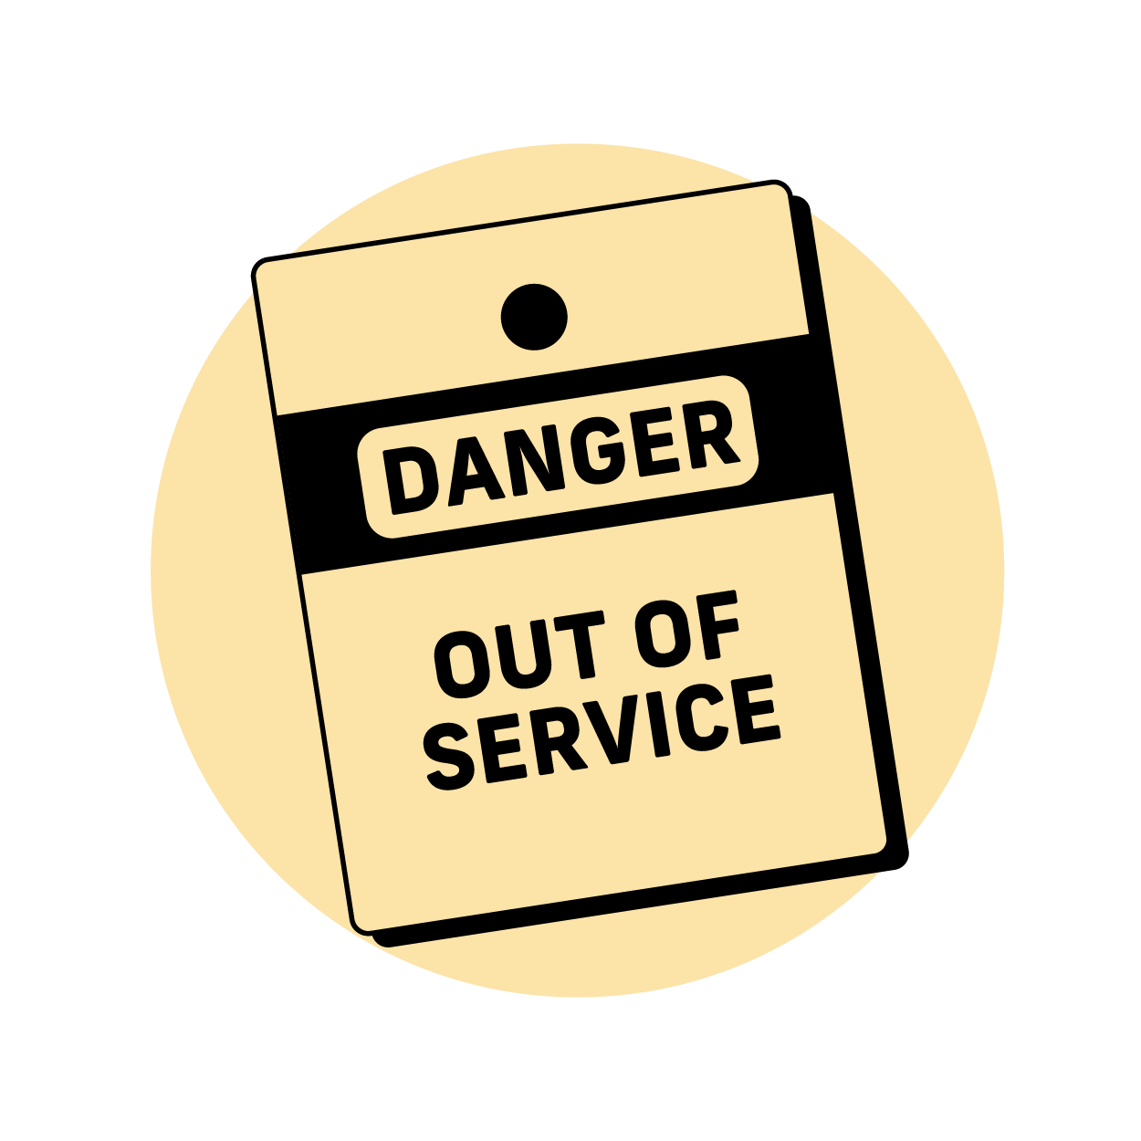


IMMINENT
WHEN THERE’S A HIGH RISK OF FLOODS OR STORMS, YOU NEED TO BE PREPARED.
Your first priority is to secure your depot or business. Only once you’ve done this should you begin helping the community
FOR YOUR SITE
FOR THE COMMUNITY
SECURE
Secure as much as you can.
ISOLATE
Isolate as much as you can
(paying special attention to pumps, motors and the power supply).
ENSURE
Ensure cylinder installation
is compliant.
ENSURE
Make sure cylinders are installed correctly.
Notes:
SPEAKER NOTES:
We won’t always receive a lot of warning before a flood arrives so it’s important to know what’s important and what’s not.
On site, we should secure as much as we can. This means locking up all cages and securing everything movable to a fixed structure. We should also isolate as much as we can, paying special attention to pumps, motors and the power supply.
When it comes to helping the community, the most important things we can do are to make sure all the cylinders we install are fully compliant. This includes checking back on refillable cylinders as we all know that sometimes customers make changes to their property that results in the cylinder installation no longer being compliant!
We should also encourage all customers to tether their cylinders to a fixed structure. This will usually be the side of their house.

Slide 6




WHEN A FLOOD OR STORM OCCURS, YOUR FIRST PRIORITY IS TO STAY SAFE.
MONITOR
Stay safe and don’t enter the flood zone. Monitor the situation and start preparing your post-flood recovery plan. Be prepared to adapt your response if needed.
INFORM
You’ll almost certainly see an increase in customer requests. Ensure your customer service teams are informed, appropriately resourced and have relevant flood advice ready. We will provide a link to a range of resources to help you do this at the end of the presentation.
NOTIFY
Regularly notify customers about actions they can take to keep themselves and their communities safe.
ADVISE
Advise customers on what to do if there’s a LP Gas leak.
Notes:
SPEAKER NOTES:
The single most important thing to do when a flood or storm occurs is to keep ourselves safe.
Monitor the situation, consider our recovery plan and adapt it if needed.
Make sure our customer service teams are informed, appropriately resourced and able to deliver relevant information to customers. If we need additional support here, there are a range of resources to help. There’s a link at the end of the presentation.
We can also reach out directly to our customers to make sure they’re safe. We can either do this directly through phone calls or share our LP Gas flood safety resources via Facebook, text, email print or more.

Slide 7




ONCE THE WORST OF THE FLOOD OR STORM HAS PASSED, YOU’LL NEED TO IMPLEMENT YOUR RESPONSE PLAN.
MONITOR
Stay safe and don’t enter the flood zone. Monitor the situation and start preparing your post-flood recovery plan. Be prepared to adapt your response if needed.
PREPARE
Ensure LP Gas fitters have ordered additional pigtails and regulators to prepare for the increased demand.
UNDERSTAND
Ensure that drivers understand and are prepared to follow.
IMPLEMENT
Implement the required emergency response.
If needed, call 000.
Notes:
SPEAKER NOTES:
During the event is when the bulk of our work will take place. If we’ve put in place the things we discussed previously then our team should be well briefed on how to respond.
One of the first things we should do is reach out to customers who may have been affected by the event. This will help identify those most in need of help but will also help us begin to track the number of cylinders that have been lost during the flood or storm event.
LP Gas fitters should make sure they order additional pigtails and regulators to cope with the increased demand.
It’s also important that drivers are well acquainted with the procedures we have in place as they’ll likely be the ones interacting with customers.
Always remember that if you have any doubts, call 000 and wait for emergency services to arrive.

Slide 8




RECOVERING LP GAS CYLINDERS
IN THE AFTERMATH OF A FLOOD OR STORM, THERE ARE LIKELY TO BE A SIGNIFICANT NUMBER OF LOST CYLINDERS.
When these are found, LP Gas fitters will need to assess them and implement the following process:
TURN OFF
Turn the gas off if safe to do so.
KEEP UPRIGHT
Stand it upright if safe to do so.
NO IGNITION
Make sure there are no ignition sources in the area.
KEEP CLEAR
Keep clear and wait for emergency services to come.
Notes:
SPEAKER NOTES:
No matter how prepared our community is, recovering and assessing cylinders will be a significant part of our post-flood response.
If the cylinder hasn’t been isolated and it’s safe to do so, turn off the gas.
Keep the area clear of people, pets and ignition sources such as flames, sparks, smokers, or electrical appliances.
If you have any doubts about your safety or the safety of others in the area, keep clear and contact emergency services on 000.

Slide 9



KEY
LEARNINGS
STAY SAFE
Your personal safety is the most important thing. Never put yourself at risk.
EMERGENCY
Call emergency services on 000 if needed.
INFORMATION
Scan the QR code for additional information and community resources.
Notes:
SPEAKER NOTES:
Thanks for taking the time to learn about LP Gas safety during a flood or storm event. If there’s one thing that to take away from this it’s that your personal safety is the most important thing. No matter what, don’t put yourself at risk unnecessarily. If you have any doubts or see anything dangerous, call emergency services on 000.
To learn more, scan the QR code to access a range of helpful documents. There are several resources that we can distribute to our local community to help them do their part.
Does anyone have any questions?

Slide 10

STAY LP GAS SAFE
For additional information and LP Gas safety resources, visit: gasenergyaus.au/policies.html
Notes:
SPEAKER NOTES:
Thanks!

